Slide 1


Getting ready for the workplace
Marlene Canuel
Career Counselor
Career Transition Coordinator – Bishop’s University

Slide 2
Getting ready for the workplace
Networking
Resume Check List
Interview Prep Tips

Slide 3

LET'S TALK ABOUT NETWORKING
This Photo by Unknown author is licensed under CC BY-SA-NC.

Slide 4

“[The] most powerful tools to use as an individual […] knowing the right people can get you places that you might not reach otherwise”
- S. RoAne, 2018

Slide 5

YOUR TO DO LIST
Use Social Networks such as LinkedIn
Connect with Alumni from your institution
Be visible : go to events, connect, listen, offer your help, volunteer, be involved, etc.

Slide 6

REMEMBER
Networking is about listening and helping others

Slide 7
Why employers want your resume?
Are you meeting the job requirements?
Have you performed similar tasks in another position or have volunteering experience (How much training will you need)?
Rank the different candidates to identify the ones who will be called for an interview

Slide 8
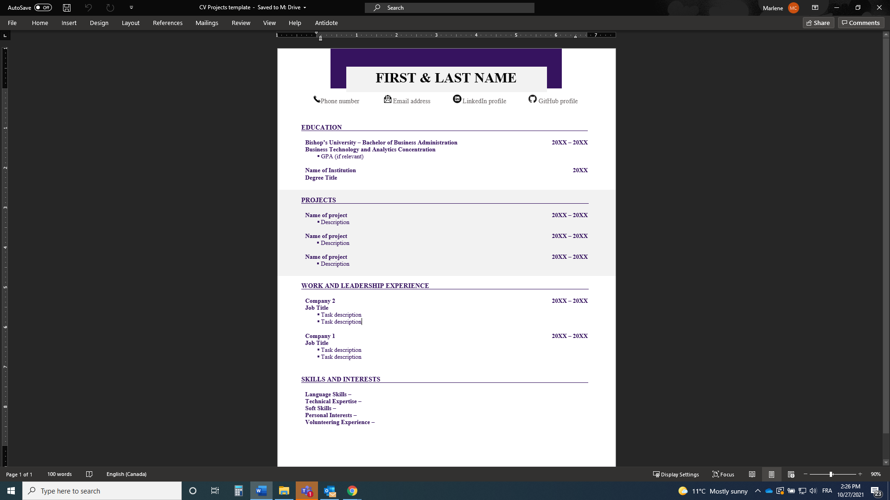
Contact Information
  Full name
  Phone number
  Professional email
  LinkedIn profile (customized)
Education
  Diploma + date of graduation
  GPA
  Volunteering, social implication
  Awards, bursaries, achievements
Projects
  Any projects in school/classes you have done
Professional Experience
  Present the jobs you’ve held, in reverse chronological order.
  Use different action verbs and key words to describe your responsibilities
  The description of your tasks should start with the tasks that are most relevant to the job or that required the most responsibilities
Skills and Interests
  Languages, software, skills, volunteering experience, etc.

Slide 9




INTERVIEW PREPARATION
Act like an athlete!
This Photo by Unknown author is licensed under CC BY.
This Photo by Unknown author is licensed under CC BY-SA.
This Photo by Unknown Author is licensed under CC BY-SA

Slide 10
INTERVIEWS: THE STEPS
YOUR STORY
MOTIVATIONAL BEHAVIORAL QUESTIONS
TECHNICAL QUESTIONS
DO YOU HAVE QUESTIONS?

Slide 11

MIND MAPPING
Prepare different stories from your past experiences:
  Leadership / Problem solving
  Teamwork / Dealing with conflict
  Failures / Accomplishments
  Strengths / Weaknesses
  Values
Connect these stories with the job posting’s requirements/ qualifications

Slide 12
STAR METHOD
SITUATION: Short description of the situation
TASK: Describe what you were asked to do
ACTION: Explain the steps you took to handle the task
RESULTS: Describe the outcomes of your actions

Slide 13

THE FINAL TEST
Do you have questions?

Slide 14


Slide 15


